Slide 1

Regression

Slide 2
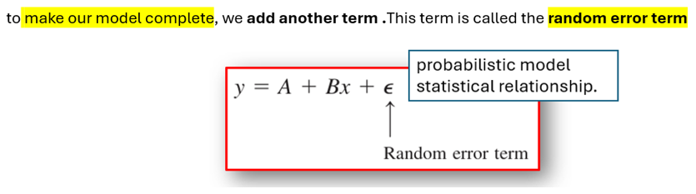
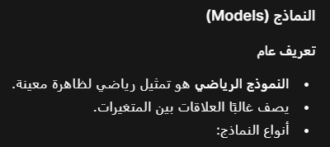
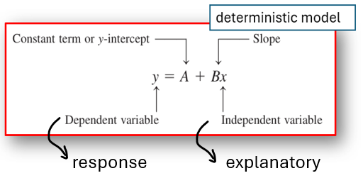
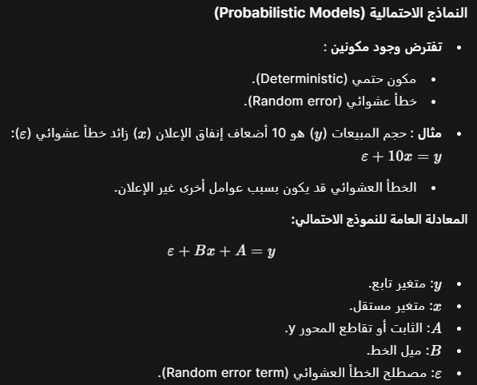
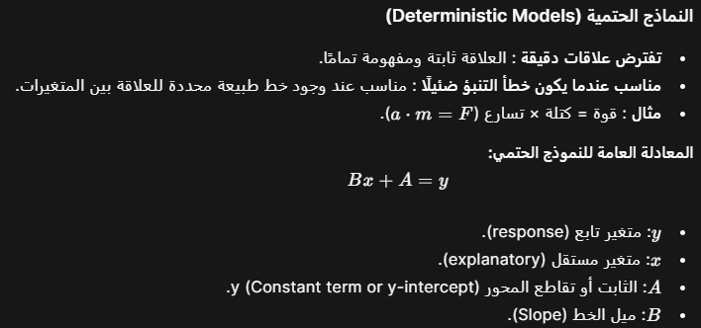


Slide 3

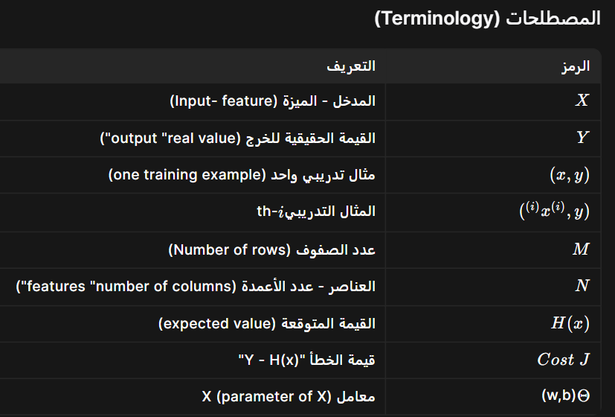


Slide 4
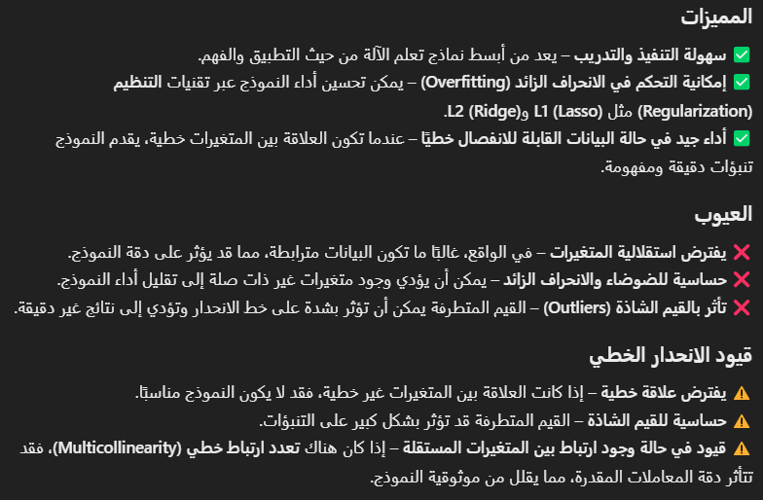


Slide 5

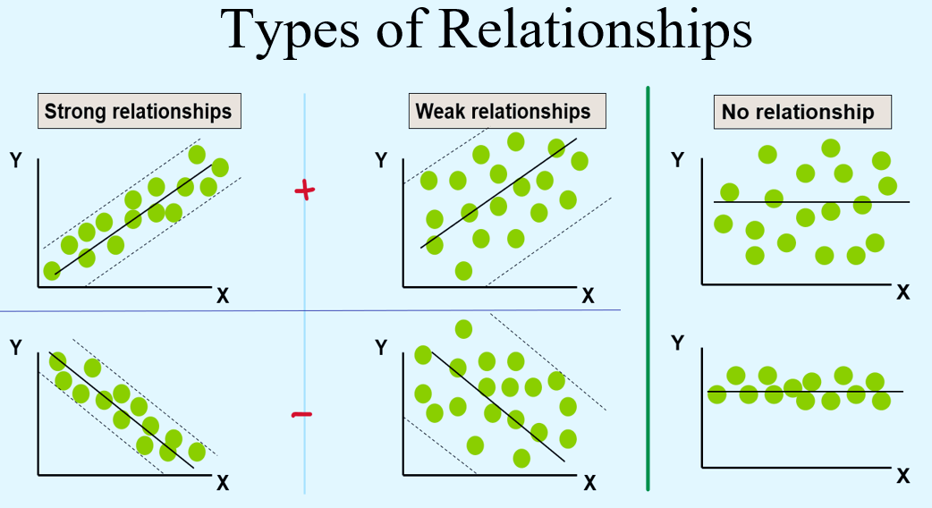
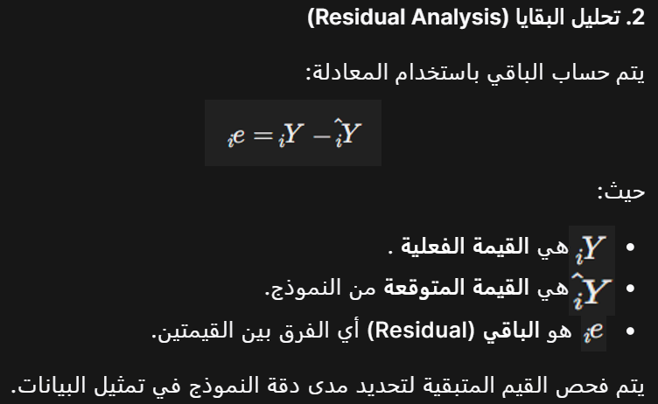

Slide 6
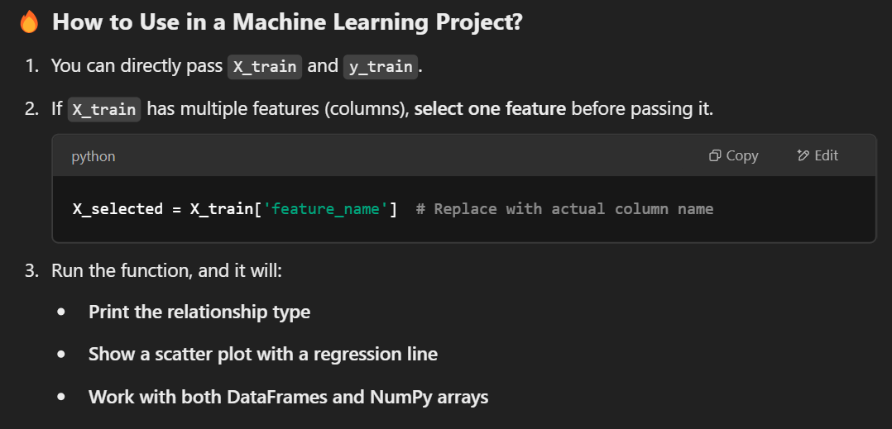
import numpy as np
import pandas as pd
import seaborn as sns
import matplotlib.pyplot as plt
def determine_relationship(X, Y, plot=True):
"""
Determine the type of relationship between X and Y based on correlation.
Parameters:
- X: Independent variable (can be from X_train)
- Y: Dependent variable (can be from y_train)
- plot: Whether to display a scatter plot with a regression line (default = True)
Returns:
- A string indicating the type of relationship (Strong, Weak, or No Relationship)
"""
# Convert to DataFrame for correlation calculation
df = pd.DataFrame({'X': X, 'Y': Y})
correlation = df['X'].corr(df['Y'])
# Determine relationship type based on correlation value
if abs(correlation) > 0.7:
relation_type = "Strong Relationship"
elif abs(correlation) > 0.3:
relation_type = "Weak Relationship"
else:
relation_type = "No Relationship"
# Plot if required
if plot:
plt.figure(figsize=(5, 4))
sns.regplot(x=X, y=Y, scatter_kws={'alpha': 0.7}, line_kws={'color': 'red'})
plt.title(f"{relation_type}\nCorrelation: {correlation:.2f}")
plt.xlabel("X")
plt.ylabel("Y")
plt.show()
return relation_type
# ✅ Example usage with training data (X_train, y_train)
# Assuming X_train is a 2D DataFrame, we take one feature (column)
# Replace 'feature_name' with the actual feature column name
# Example if X_train is a DataFrame with multiple features
X_selected = X_train['feature_name'] # Select a single feature
# Example usage
# print(determine_relationship(X_selected, y_train))
print(model.summary())

Slide 7
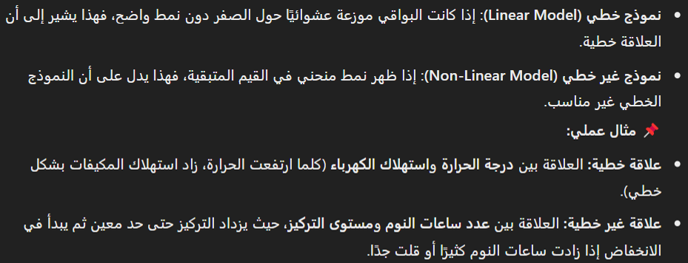
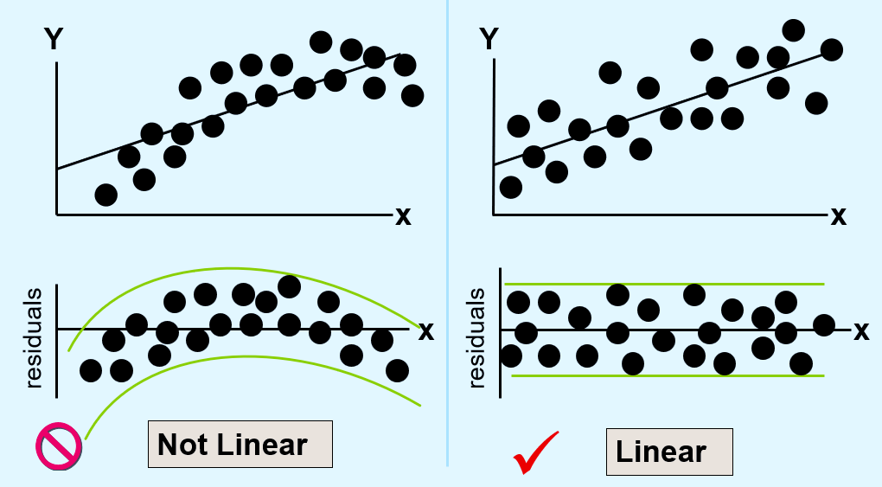
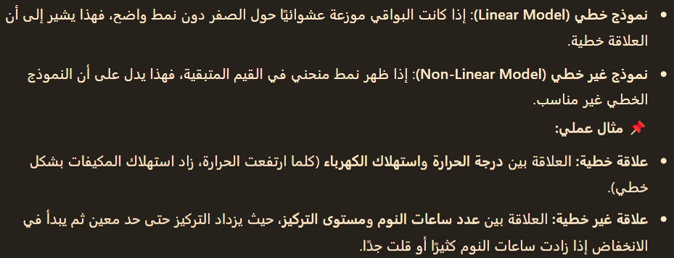

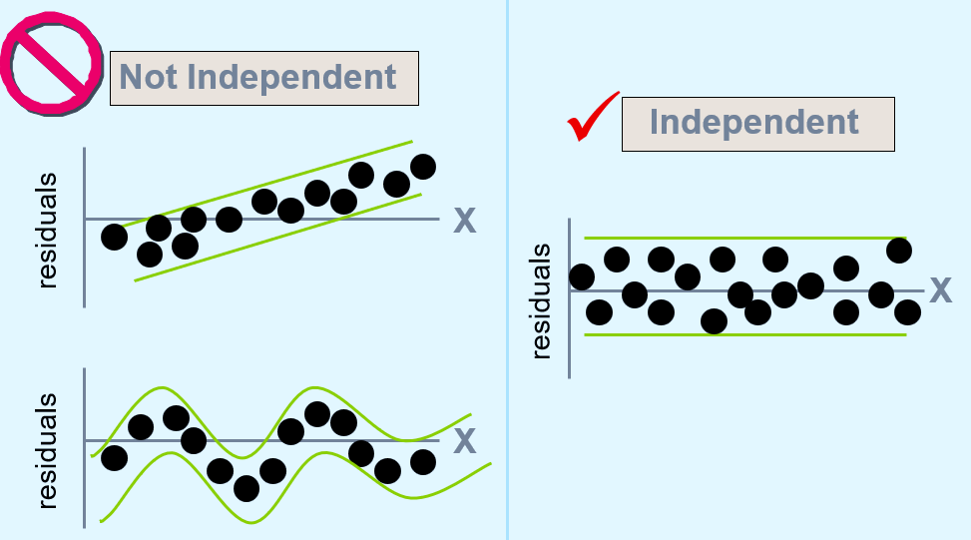


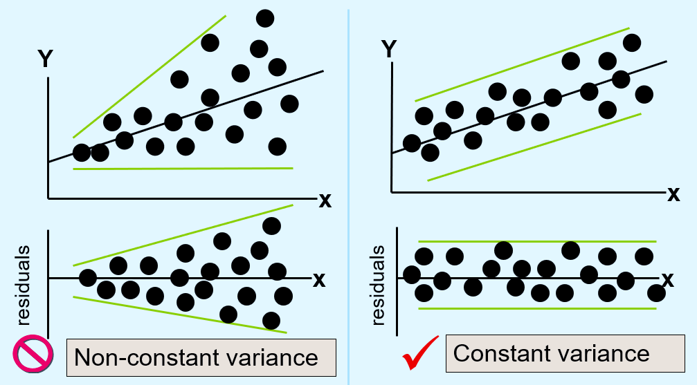
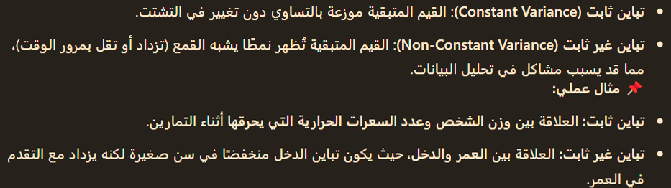

Slide 8
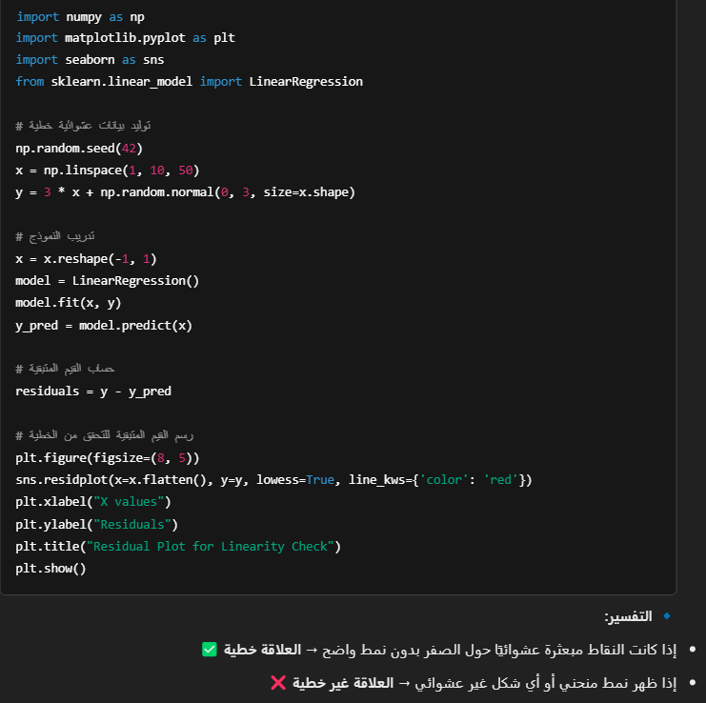
import numpy as np
import matplotlib.pyplot as plt
import seaborn as sns
from sklearn.linear_model import LinearRegression
np.random.seed(42)
x = np.linspace(1, 10, 50)
y = 3 * x + np.random.normal(0, 3, size=x.shape)
x = x.reshape(-1, 1)
model = LinearRegression()
model.fit(x, y)
y_pred = model.predict(x)
residuals = y - y_pred
plt.figure(figsize=(8, 5))
sns.residplot(x=x.flatten(), y=y, lowess=True, line_kws={'color': 'red'})
plt.xlabel("X values")
plt.ylabel("Residuals")
plt.title("Residual Plot for Linearity Check")
plt.show()

Slide 9
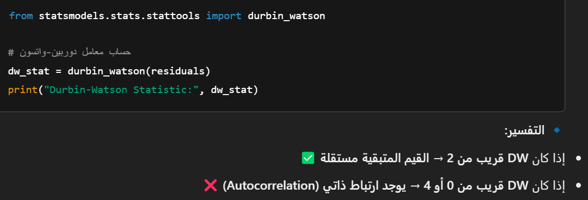
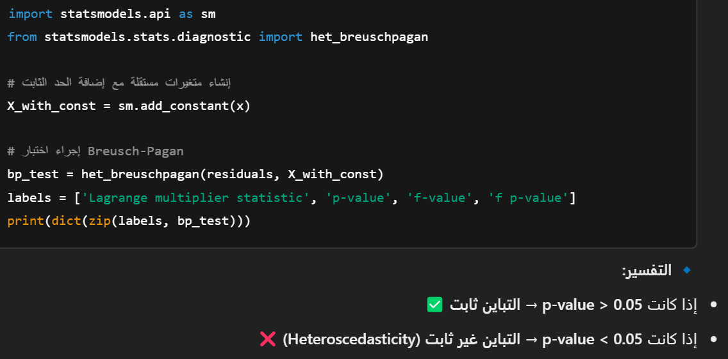
from statsmodels.stats.stattools import durbin_watson
dw_stat = durbin_watson(residuals)
print("Durbin-Watson Statistic:", dw_stat)
import statsmodels.api as sm
from statsmodels.stats.diagnostic import het_breuschpagan
X_with_const = sm.add_constant(x)
bp_test = het_breuschpagan(residuals, X_with_const)
labels = ['Lagrange multiplier statistic', 'p-value', 'f-value', 'f p-value']
print(dict(zip(labels, bp_test)))

Slide 10
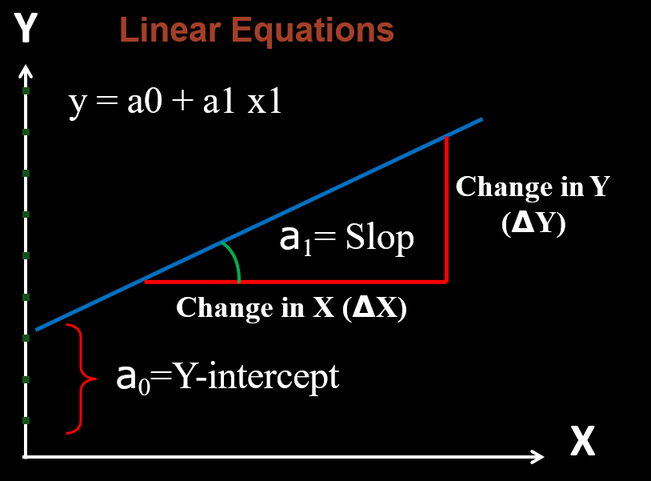

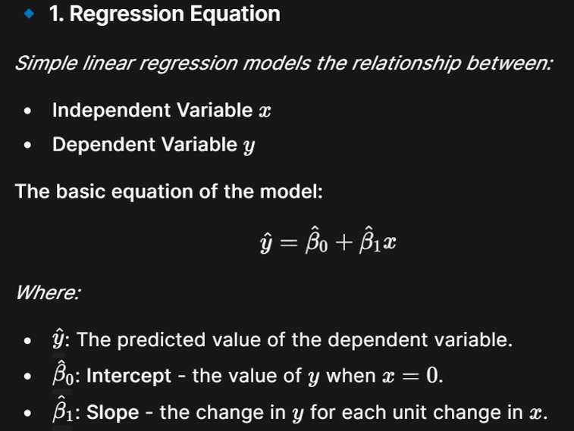
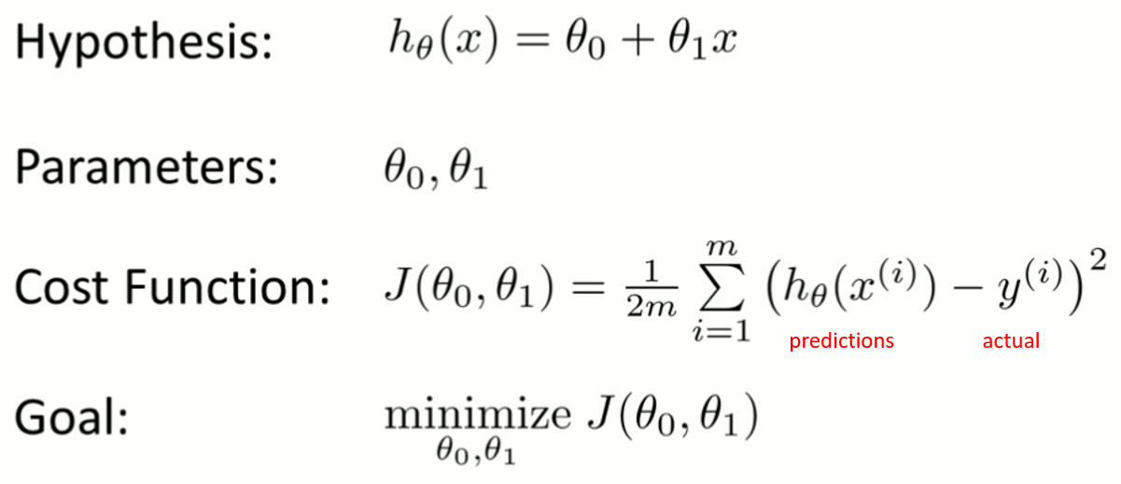
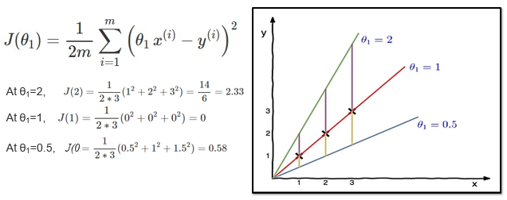
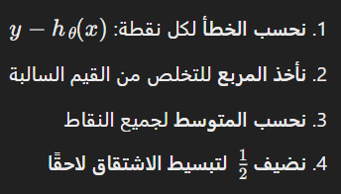
Linear regression with one variable

Slide 11

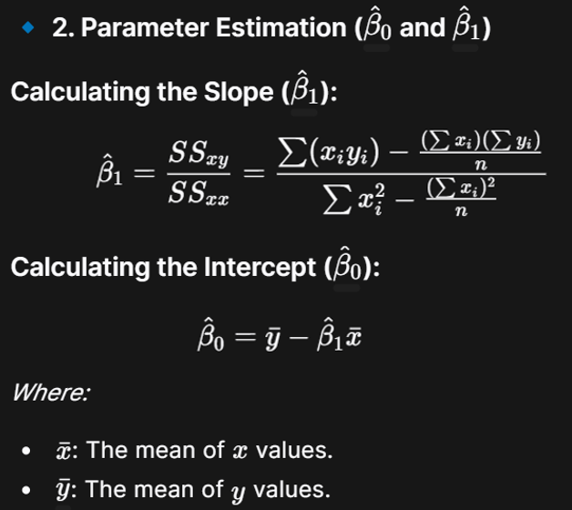
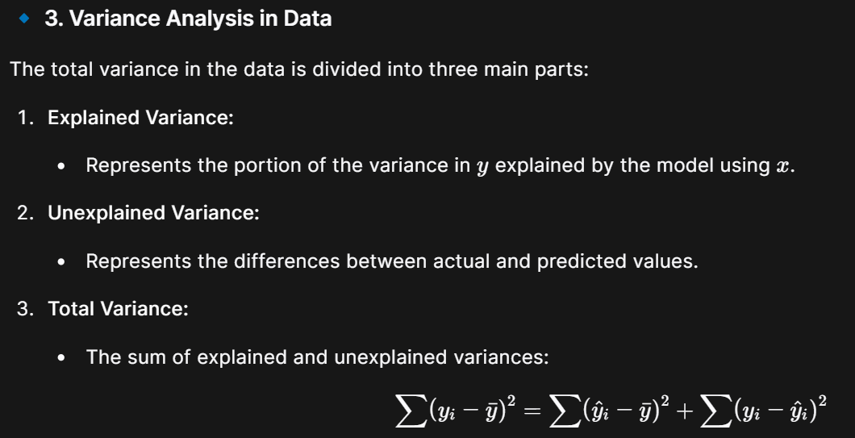


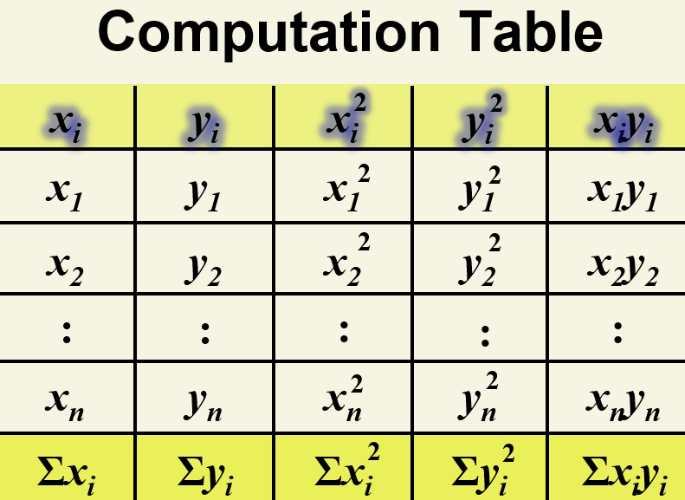

Compute Regression Coefficients

Slide 12
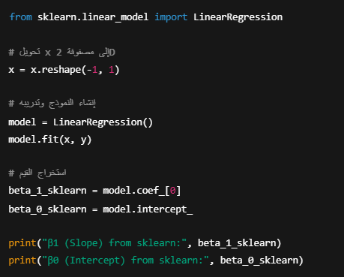

from sklearn.linear_model import LinearRegression
x = x.reshape(-1, 1)
model = LinearRegression()
model.fit(x, y)
beta_1_sklearn = model.coef_[0]
beta_0_sklearn = model.intercept_
print("β1 (Slope) from sklearn:", beta_1_sklearn)
print("β0 (Intercept) from sklearn:", beta_0_sklearn)

Slide 13
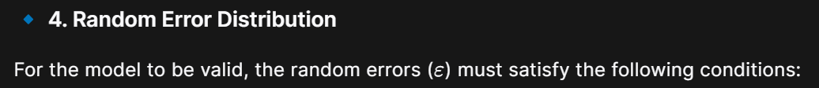



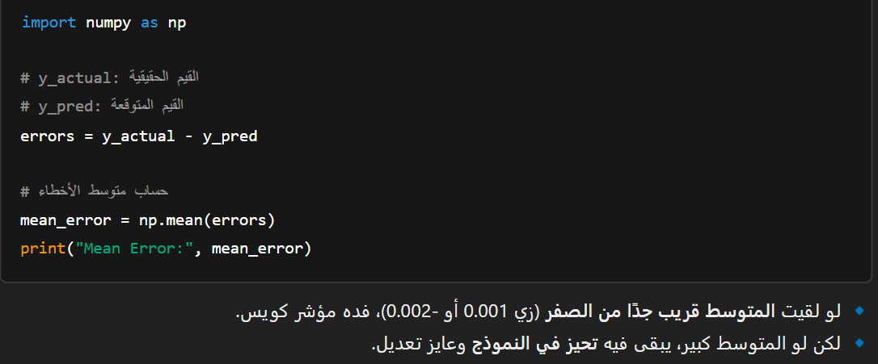
import numpy as np
errors = y_actual - y_pred
mean_error = np.mean(errors)
print("Mean Error:", mean_error)
تم ذكره سابقا

Slide 14



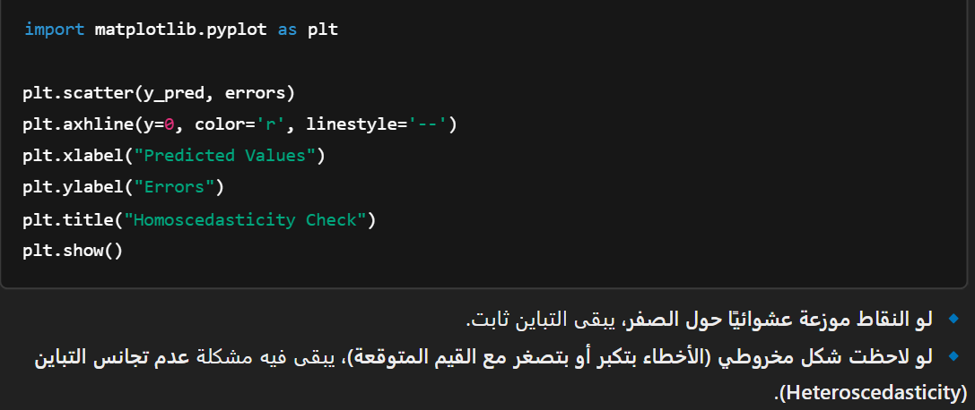
import matplotlib.pyplot as plt
plt.scatter(y_pred, errors)
plt.axhline(y=0, color='r', linestyle='--')
plt.xlabel("Predicted Values")
plt.ylabel("Errors")
plt.title("Homoscedasticity Check")
plt.show()

Slide 15



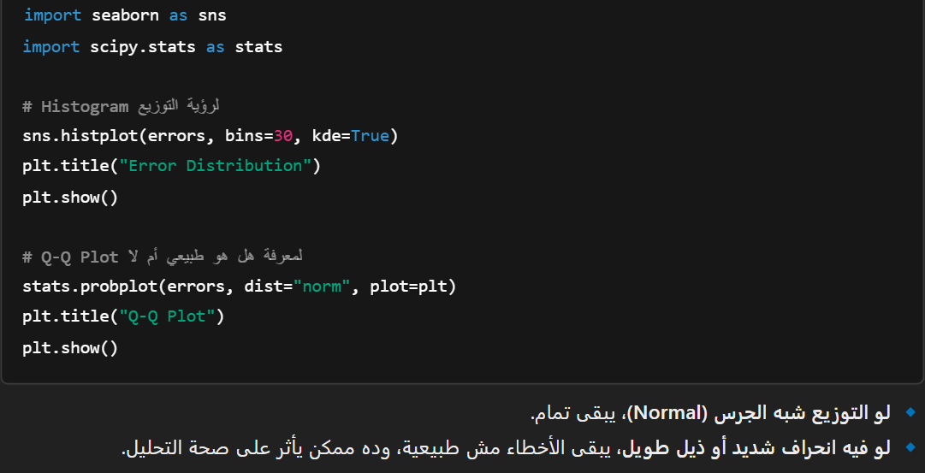
import seaborn as sns
import scipy.stats as stats
sns.histplot(errors, bins=30, kde=True)
plt.title("Error Distribution")
plt.show()
stats.probplot(errors, dist="norm", plot=plt)
plt.title("Q-Q Plot")
plt.show()

Slide 16



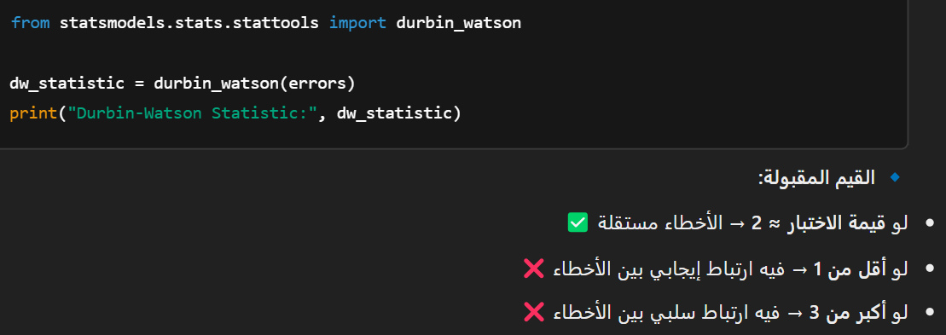
from statsmodels.stats.stattools import durbin_watson
dw_statistic = durbin_watson(errors)
print("Durbin-Watson Statistic:", dw_statistic)
تم ذكره سابقا

Slide 17
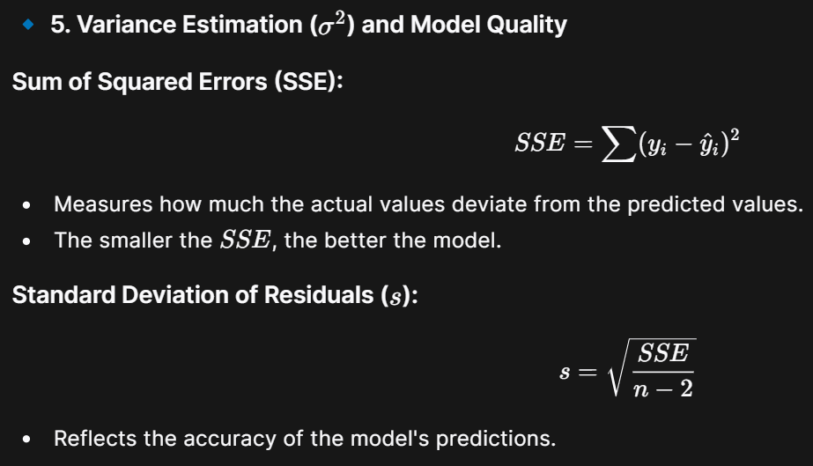

import numpy as np
errors = y_actual - y_pred
SSE = np.sum(errors**2)
print("SSE:", SSE)
n = len(y_actual)
s = np.sqrt(SSE / (n - 2))
print("Standard Deviation of Residuals (s):", s)

Slide 18

Gradient Descent

Slide 19
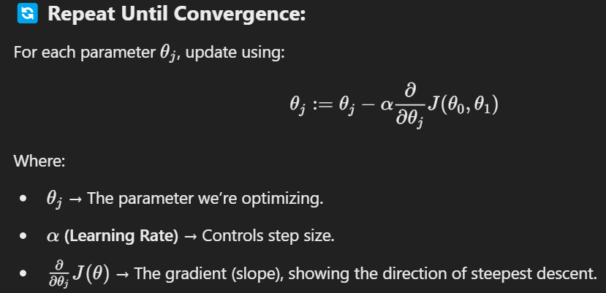
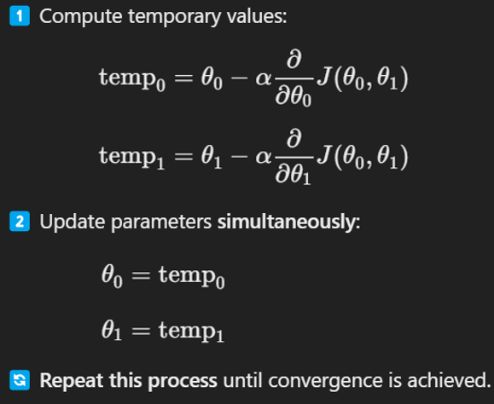
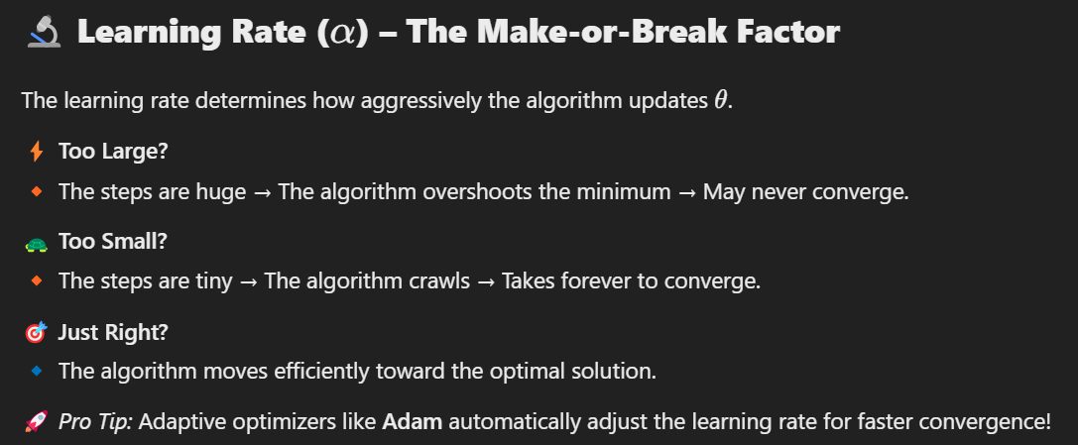

Slide 20
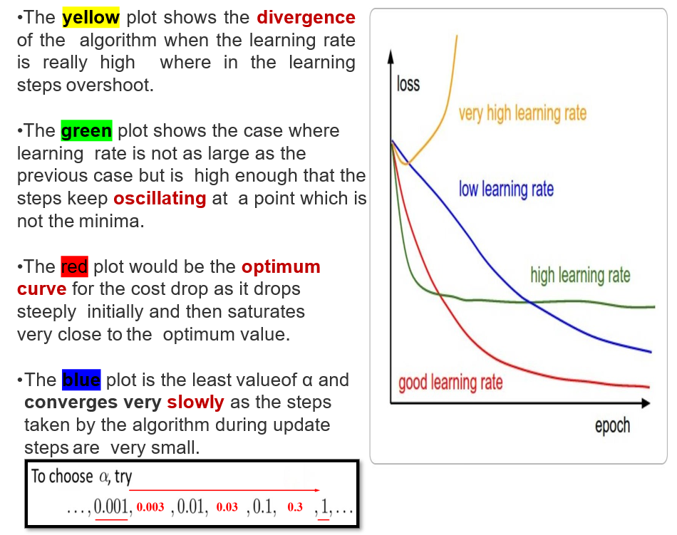




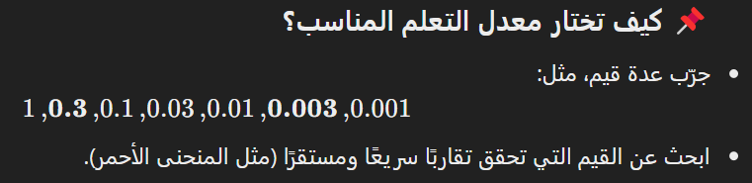

Slide 21
import numpy as np
import matplotlib.pyplot as plt
"""
Analyze the learning curve based on loss values and learning rate,
and plot the curve with a professional visualization.
Parameters:
- loss_values (list or np.array): Sequence of loss values over epochs.
- learning_rate (float): The learning rate used during training.
Returns:
- str: A description of the learning curve type.
"""
def analyze_learning_curve(loss_values, learning_rate):
if not isinstance(loss_values, (list, np.ndarray)) or len(loss_values) < 2:
raise ValueError("loss_values must be a list or numpy array with at least two elements.")
initial_loss = loss_values[0]
final_loss = loss_values[-1]
if any(loss > 10 * initial_loss for loss in loss_values):
curve_type = "Divergence:\nLearning rate too high"
color = 'red'
elif len(loss_values) >= 3 and all(
abs(loss_values[i] - loss_values[i-2]) > abs(loss_values[i] - loss_values[i-1])
for i in range(2, len(loss_values))):
curve_type = "Oscillation:\nLearning rate too high"
color = 'orange'
elif final_loss < 0.1 * initial_loss:
curve_type = "Optimal:\nLearning rate is good"
color = 'green'
else:
curve_type = "Slow Convergence:\nLearning rate too low"
color = 'blue'
plt.figure(figsize=(10, 5))
plt.plot(loss_values, marker='o', linestyle='-', color=color, label=f"LR={learning_rate}\n{curve_type}")
plt.title(f'Learning Curve Analysis', fontsize=14, fontweight='bold')
plt.xlabel('Epochs', fontsize=12)
plt.ylabel('Loss', fontsize=12)
plt.grid(True, linestyle='--', alpha=0.6)
plt.xticks(fontsize=10)
plt.yticks(fontsize=10)
plt.legend(loc="upper right", fontsize=10, frameon=True, fancybox=True, shadow=True, borderpad=1)
plt.show()
return curve_type
from sklearn.model_selection import train_test_split
from sklearn.linear_model import SGDRegressor
from sklearn.metrics import mean_squared_error
np.random.seed(42)
X = 2 * np.random.rand(100, 1)
y = 4 + 3 * X + np.random.randn(100, 1)
X_train, X_test, y_train, y_test = train_test_split(X, y, test_size=0.2, random_state=42)
learning_rate = 0.01
epochs = 3
loss_values = []
sgd = SGDRegressor(learning_rate="constant", eta0=learning_rate, max_iter=1, tol=None)
for epoch in range(epochs):
sgd.partial_fit(X_train, y_train.ravel())
y_pred = sgd.predict(X_train)
loss = mean_squared_error(y_train, y_pred)
loss_values.append(loss)
analyze_learning_curve(loss_values, learning_rate)
y_test_pred = sgd.predict(X_test)
test_loss = mean_squared_error(y_test, y_test_pred)
print(f"Final Training Loss: {loss_values[-1]:.4f}")
print(f"Test Loss: {test_loss:.4f}")

Slide 22


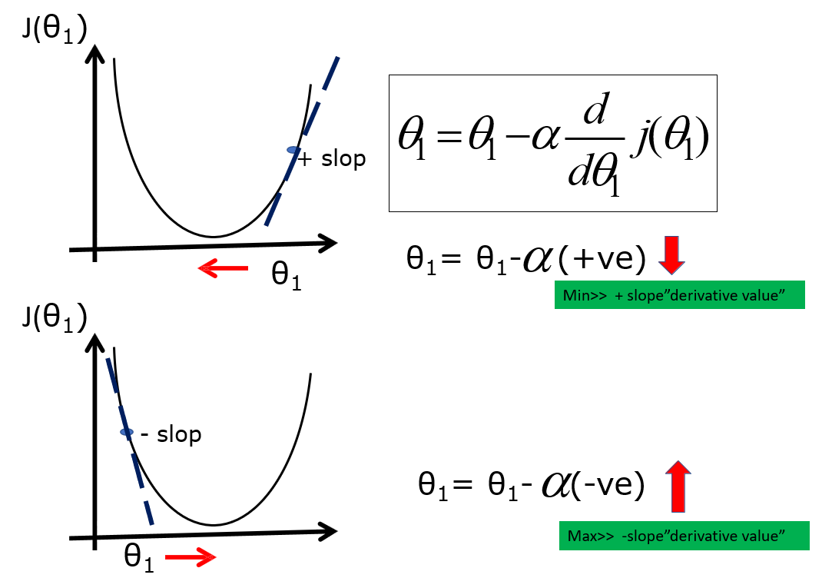
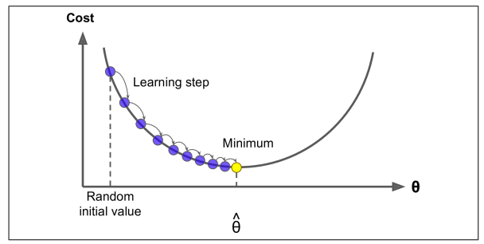
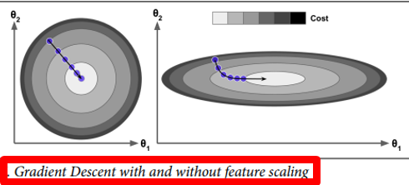
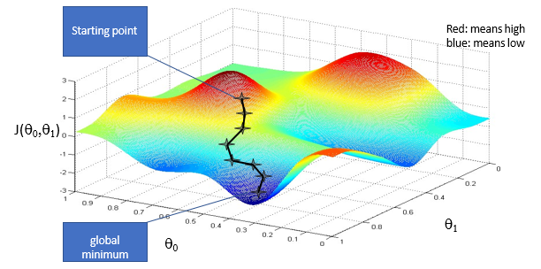
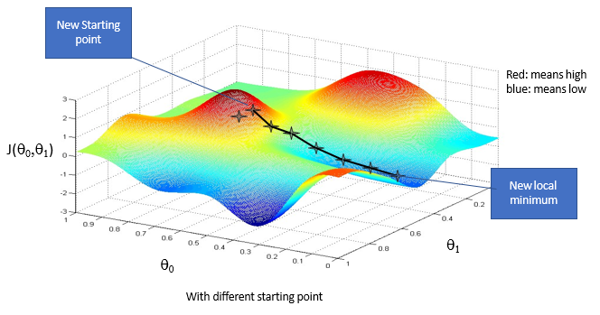

Slide 23
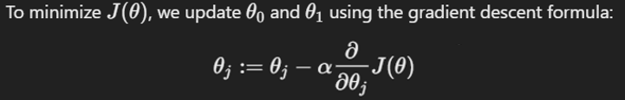
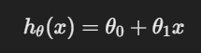
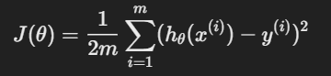
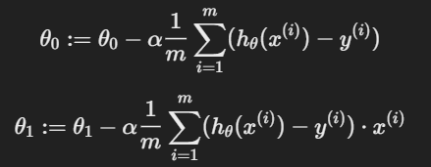
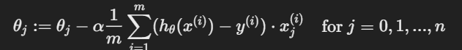
Linear Regression Model
Generalization for Multiple Features (Multivariable Regression)

Slide 24
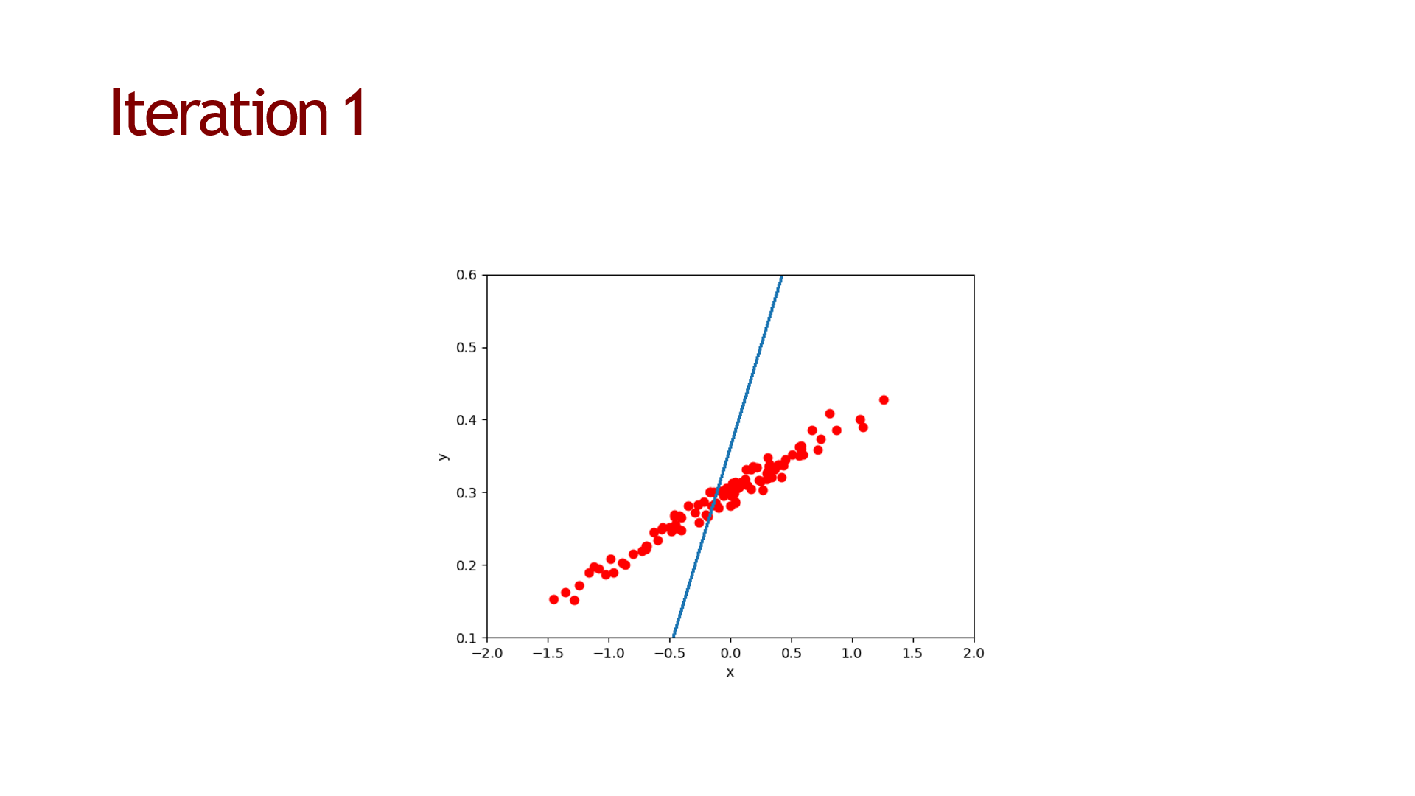











Slide 25
Gradient Descent Types

Slide 26








Slide 27



from sklearn.linear_model import SGDRegressor
import numpy as np
# توليد بيانات عشوائية
X = np.random.rand(1000, 5) # 1000 عينة، 5 ميزات
y = np.random.rand(1000)
# إنشاء النموذج
model = SGDRegressor()
# تطبيق Mini-batch GD بتحديث النموذج باستخدام أجزاء صغيرة من البيانات
batch_size = 32
for i in range(0, len(X), batch_size):
X_batch = X[i:i+batch_size]
y_batch = y[i:i+batch_size]
model.partial_fit(X_batch, y_batch)

Slide 28

Linear Regression with Multiple Variables
Multivariate Linear Regression uses several explanatory (independent) variables to predict the outcome of a response (dependent) variable.
y = a0 + a1 x1+ a2 x2+ a3 x3+ ...... an x

Slide 29









Slide 30



Slide 31






Slide 32




Slide 33
import numpy as np
import matplotlib.pyplot as plt
from sklearn.preprocessing import PolynomialFeatures
from sklearn.linear_model import LinearRegression
def polynomial_regression(X, y, degree=2, plot_results=True):
"""
A general function to perform polynomial regression on a given dataset.
Parameters:
- X (array-like): Input feature data (e.g., np.array of shape (n_samples, 1)).
- y (array-like): Target values (e.g., np.array of shape (n_samples, 1)).
- degree (int, optional): Degree of the polynomial (default=2).
- plot_results (bool, optional): Whether to plot the original data and fitted curve (default=True).
Returns:
- model: Trained LinearRegression model.
- y_pred: Predicted values based on the model.
"""
# 1️⃣ Transform the input data into polynomial features
poly = PolynomialFeatures(degree=degree)
X_poly = poly.fit_transform(X)
# 2️⃣ Train the linear regression model on the transformed features
model = LinearRegression()
model.fit(X_poly, y)
# 3️⃣ Predict values using the trained model
y_pred = model.predict(X_poly)
# 4️⃣ Plot the results if requested
if plot_results:
plt.scatter(X, y, color='blue', label="Original Data")
plt.plot(X, y_pred, color='red', linewidth=2, label=f"Polynomial Regression (Degree {degree})")
plt.xlabel("X")
plt.ylabel("y")
plt.title(f"Polynomial Regression (Degree {degree})")
plt.legend()
plt.grid(True)
plt.show()
return model, y_pred
# Generate sample non-linear data
np.random.seed(42) # For reproducibility
X = np.linspace(0, 10, 50).reshape(-1, 1)
y = 2 + 3 * X - 0.5 * X**2 + np.random.randn(50, 1) * 2
# Apply polynomial regression with degree 2
model, y_pred = polynomial_regression(X, y, degree=2)
degrees = [1, 2, 3, 4, 5]
plt.figure(figsize=(12, 6))
for i, d in enumerate(degrees, 1):
plt.subplot(2, 3, i)
_, y_pred = polynomial_regression(X, y, degree=d, plot_results=False)
plt.scatter(X, y, color='blue', label="Original Data")
plt.plot(X, y_pred, color='red', linewidth=2, label=f"Degree {d}")
plt.xlabel("X")
plt.ylabel("y")
plt.legend()
plt.title(f"Polynomial Regression (Degree {d})")
plt.tight_layout()
plt.show()

Slide 34






Evaluating Regression Models Performance

Slide 35

 | MAE Mean Absolute Error | MSE Mean Squared Error | RMSE Root Mean Squared Error | MAPE Mean Absolute Percentage Error | R² R Squared
المعادلة | $$\frac{\sum_{i=1}^{n}{\left|y_{i}−{\hat{y}}_{i}\right|}}{n}$$ | $$\frac{\sum_{i=1}^{n}{{(y_{i}−{\hat{y}}_{i})}^{2}}}{n}$$ | $$\sqrt{\frac{\sum_{i=1}^{n}{{(y_{i}−{\hat{y}}_{i})}^{2}}}{n}}$$ | $$\frac{100\sum_{i=1}^{n}{\left|y_{i}−{\hat{y}}_{i}\right|}}{n}$$ | $$1−\frac{\sum_{i=1}^{n}{{(y_{i}−{\hat{y}}_{i})}^{2}}}{\sum_{i=1}^{n}{{(y_{i}−\overline{y})}^{2}}}$$
الوصف | يقيس متوسط الفروقات المطلقة بين القيم الحقيقية والتنبؤات | يقيس متوسط مربعات الفروقات بين القيم الحقيقية والتنبؤات | هو الجذر التربيعي لمتوسط مربعات الفروقات بين القيم الحقيقية والتنبؤات | يقيس متوسط نسبة الخطأ المطلق بالنسبة للقيم الحقيقية | يوضح مدى تفسير النموذج للتباين في البيانات
حساس للقيم المتطرفة | ❌ | ✅ | ✅ | ❌ | ❌
العقاب علي الاخطاء الكبيرة | ❌ لا يعاقب بشكل خاص علي الاخطاء الكبيرة | ✅ يعاقب الأخطاء الكبيرة بشكل أكبر | ✅ يعاقب الأخطاء الكبيرة بشكل أكبر | ❌ لا يعاقب بشكل خاص علي الاخطاء الكبيرة | ❌ لا يعاقب بشكل خاص علي الاخطاء الكبيرة
وحدة البيانات | ✅ يُعبّر عن نفس وحدة البيانات | ❌ يُعبّر عن مربع وحدة البيانات | ✅ يُعبّر عن نفس وحدة البيانات | ❌ يُعبّر عن نسبة مئوية (%) | ❌ بدون وحدة
مناسب للمقارنة بين النماذج؟ | ✅ | ✅ | ✅ | ❌ | ✅ الافضل عند مقارنة النماذج، لكن لا يقيس الخطأ مباشرة
يعمل مع القيم الصفرية؟ | ✅ | ✅ | ✅ | ❌ لا يعمل جيدًا مع القيم الصفرية أو القريبة من الصفر بسبب القسمة | ✅
أفضل حالات الاستخدام | عندما يكون الهدف فهم متوسط الخطأ دون تضخيم القيم الكبيرة. | عندما يكون الهدف تقليل الأخطاء الكبيرة بشكل أكبر. | عندما نريد مقياسًا سهل الفهم بنفس وحدة البيانات الأصلية. | عندما يكون المطلوب مقارنة الأداء بين مجموعات بيانات ذات نطاقات مختلفة (إذا لم يكن هناك أصفار). | عندما يكون الهدف فهم مدى تفسير النموذج للبيانات وليس فقط قياس الخطأ.

Slide 36

Regularization

Slide 37



Slide 38





